Slide 1
EMPLOYEE PAYROLL WITH GPS AND IMAGE
CSE7301 Capstone Project
FINAL REVIEW
Batch Number:69
Roll Number | Student Name
20211CSE0486 | S. NAGA BHUSHAN REDDY
20211CSE0485 | AKSHAY TADIKONDA
20211CSE0498 | BACHU VENKATA BALA NAGENDRA BABU
20211CSE0031 | CHINTA MARY KIRANMAYE
Under the Supervision of,
Dr.Jayanthi Kamalasekaran
School of computer science and engineering
jayanthi.k@presidencyuniversity.in
8446075868
Presidency university
Name of the Program: CSE
Name of the HoD: Dr.Asif Mohammed H.B
Name of the School Project Coordinators: Dr. Sampath A K / Dr. Abdul Khadar A / Mr. Md Ziaur Rahman

Slide 2
Introduction
The main goal of this project is to track employees using an Android device and automatically calculate their payroll based on the hours they’ve worked. Traditionally, attendance was recorded using old-fashioned methods like paper and pen. For example, a supervisor might take attendance by calling out names or having workers sign their names on a sheet. This project aims to replace those outdated methods with a more reliable, efficient, and automated system to ensure accurate attendance tracking and payroll calculation.
• Automate Attendance Tracking: To develop a system where employees can check in and out using a mobile app that records their GPS location and captures a live image for verification.
• Ensure Authenticity of Attendance: To prevent proxy attendance or buddy punching by using real-time image capture and geo-location verification at the time of check-in/out.

Slide 3
Literature Review
Automated Payroll With GPS Tracking And Image Capture
Managing field employees just got easier with our two-part system: a simple Android app for your team and a powerful web dashboard for managers. Here’s how it works: When employees check in, the app snaps a quick photo and pins their GPS location—sending this info straight to the admin dashboard.
Automated Payroll Using GPS Tracking and Image Capture
The main focus of this paper is to develop a system that tracks employees using an Android device and calculates their payroll based on the actual hours they work. Traditionally, attendance was recorded using simple methods like pen and paper, where supervisors would either take attendance themselves or have workers sign in under their supervision. However, this approach had many drawbacks, including the possibility of proxy attendance, where someone could sign in on behalf of another worker.

Slide 4
Existing method Drawback
1. GPS Manipulation (Location Spoofing)
Drawback: Employees can use fake GPS apps or mock locations to falsify their whereabouts.
Impact: Inaccurate location data leads to fraudulent attendance and payroll discrepancies.
2. Image-based Attendance Vulnerabilities
Drawback: Photo-based systems can be tricked using printed images or videos.
Impact: Leads to "buddy punching" (one employee clocking in for another), affecting trust and data accuracy.
3. Poor Network Connectivity
Drawback: Real-time GPS tracking and image upload require stable internet access.
Impact: In remote or low-signal areas, data may not sync correctly, causing payroll errors or missed check-ins.
4. Privacy Concerns
Drawback: Constant GPS tracking and image capture can raise employee concerns over surveillance and data privacy.
Impact: May lead to reduced morale or legal issues if not handled with proper consent and transparency.
5. Battery and Device Dependency
Drawback: High battery consumption from GPS and camera use can be a burden on employees’ devices.
Impact: Frequent charging or inability to check in due to battery drain disrupts attendance tracking.
6. Data Storage and Management Issues
Drawback: Storing large volumes of image and GPS data can strain system resources.
Impact: Leads to slow performance, increased storage costs, and possible data loss if not managed properly.

Slide 5
Proposed Methodology
The System Design and Planning phase is critical in laying the foundation for the Employee Payroll Management System with GPS and Visual Verification. This phase is focused on defining the overall architecture, selecting appropriate technologies, and breaking down the system into manageable modules to ensure efficient development and functionality. It provides the blueprint for how all components will work together to meet the needs of the organization. The first step in the design process is Requirement Gathering. This involves thoroughly understanding the organization’s specific needs, which include identifying the types of employees (such as field workers, remote teams, or office staff), understanding the payroll structure (e.g., hourly rates, overtime policies, and leave systems), and gathering feedback from key stakeholders like HR, payroll teams, and managers. By collecting this information, the development team can ensure that the system addresses the real pain points of the organization and its employees
The Attendance Tracking with GPS and Visual Verification component is the core feature of the proposed employee payroll system. This system ensures accurate and secure attendance tracking, leveraging modern technology to automate and verify employee clock-ins and clock outs The system tackles common problems like time fraud, inaccurate records, and manual errors by combining GPS location tracking with visual verification methods such as photo capture or facial recognition. At the heart of this solution is a mobile-based attendance tracking feature. Employees use a user-friendly mobile app to clock in and out with just a few taps. Each time they check in or out, the app automatically records the exact time and captures their GPS location, ensuring accurate and reliable attendance data.

Slide 6
Objectives
Accurate Attendance Tracking:
Accurate attendance tracking is essential for making sure employees are paid fairly for the time they actually work. With the help of GPS technology and visual verification, the system can confirm both the location and presence of employees in real time. This helps prevent common issues like buddy punching—where someone clocks in for a coworker—and ensures that only the right people are logging their hours. Having reliable attendance data not only supports fair payroll calculations but also helps uphold the integrity of work hours across the organization.
Seamless Integration with Payroll Processing: Seamlessly connecting attendance data to the payroll system makes the entire payroll process much simpler and more efficient. Wages, overtime, and deductions are automatically calculated based on the actual hours worked, removing the need for manual data entry. This not only cuts down on errors and delays but also ensures employees are paid accurately and on time. With less time spent on handling payroll issues, HR managers can focus on other important responsibilities without the stress of payroll mistakes or discrepancies.
Enhanced Security and Fraud Prevention: When it comes to handling sensitive payroll and attendance data, security and fraud prevention are absolutely critical. The system uses multiple layers of protection, including multi-factor authentication, GPS tracking, and visual verification, to make sure that attendance records are genuine and tamper-proof. Tools like photo verification and location-based check-ins help stop dishonest practices like buddy punching. At the same time, all personal and payroll information is securely stored using encryption, keeping employee data safe and protected at all times.

Slide 7
System Design & Implementation
SYSTEM DESIGN UML:
which stands for Unified Modelling Language, is a widely used and standardized way to visualize and design software, especially when working with object-oriented programming. Developed and maintained by the Object Management Group (OMG), UML acts like a universal language that helps software teams plan out and communicate complex system designs clearly and effectively, making it easier to build and understand software together.
Currently, UML consists of two key components:
A meta-model (which defines the rules and structure of the language)
A notation (the set of visual symbols used in diagrams)
In the future, UML may also include or be paired with formal methods or processes to guide software development more comprehensively.
UML is widely used not only for designing and documenting software systems but also for business modelling and even non-software systems. It’s built on a foundation of proven engineering practices and is particularly valuable when working on large, complex systems.
By using mostly graphical notations, UML makes it easier to visualize, design, and document every aspect of a software project, making it an essential tool in object-oriented development.

Slide 8
Implementation
Module And Functionalities
Admin: The Admin Will Add Admin and HR were he can assign duty and view all the employees and make their payrolls by view their attendance which are uploaded by the employee and also view the location through the of maps.
HR: The HR will view the employees list and view their complaints and resolve the complaints.
Employee: The employee will there duty which are assigned by the admin by that date and he can upload attendance with location, then he can view all the list pays which are paid by the admin and he can rise the complaints regarding inconvenience in the work.

Slide 9
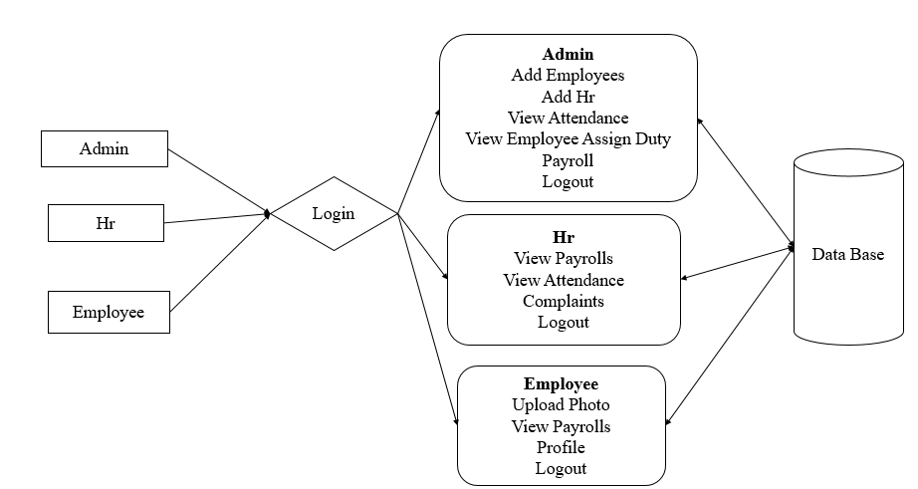
Architecture

Slide 10
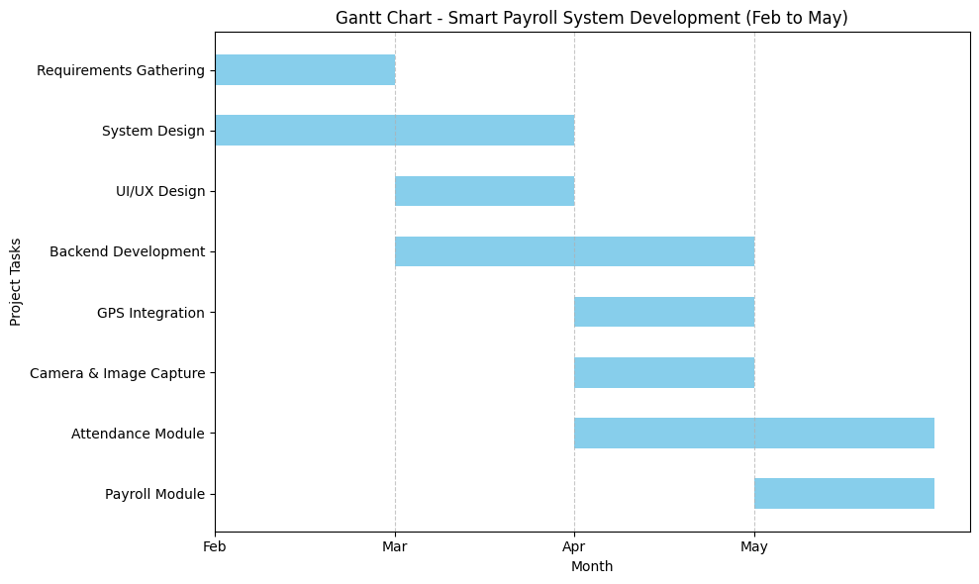
Timeline of Project

Slide 11
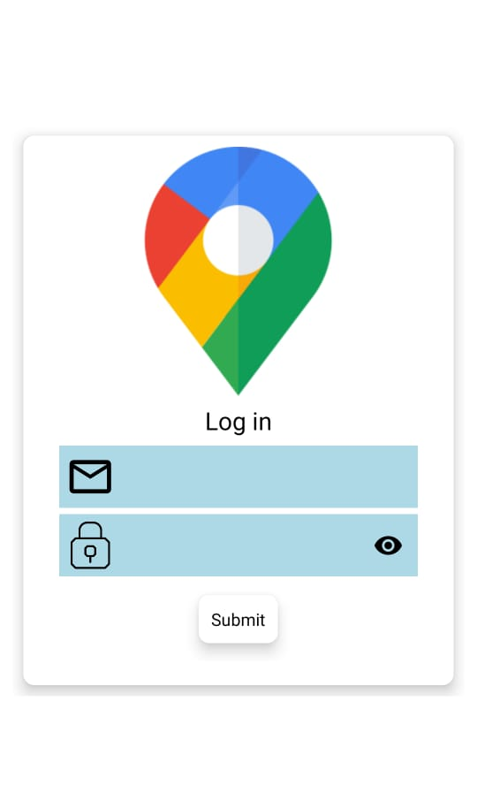
Expected Outcomes
Login screen: screen users will interact with to access the system. In perspective from left to right, the login interface consists of:
Email Address input field.
Password input field is masked with optional visibility toggle.
Submit button to get to role-based dashboard.
Visual GPS symbol indicating the system's main functionality — location tracking in real time. Only authenticated users (Admin, HR, Employee) will be able to proceed from this screen for secure, role-based access to the system.

Slide 12
Expected Outcomes
Admin Dashboard:
This screen depicts the fundamental interface for the Admin user upon successfully entering the system. The Admin Dashboard serves as the centralized repository for the system functionality related to the objectives of the project; automating payroll, employee management, complaint management, etc.
Key Functional Buttons:
Management:
This functional module enables the admin to add, view or remove, employee accounts, assign roles and monitor attendance log. These features serve the project goal of efficient and accurate workforce management.
Payroll:
The payroll accounting module allows the admin to view work hours, calculate salaries (including overtime and deductions), and provide monthly or weekly reports for payment purposes. The features will adequately meet the project's goal of automating payroll processing to ensure accurate results.
Complaints:
The complaints feature provides admins with the ability to view and rectify complaints from employees concerning attendance, payment errors, or work-related matters. The complaints feature serves to develop transparency on the part of the employer and improves employee-employer communication regarding grievances.
Log Out:
This ensures the user logs out securely, and protects sensitive employee and organization information.

Slide 13
Conclusion
This system could be useful at a universal level. It can be used among any of the companies of the word for tracking the location of the employees and especially for the employees who work in the field of marketing. As the feature of clocking in and clocking out is also included, it also helps the ADMIN department run the payroll services. It also helps the ADMIN department to mark and monitor the attendance of the employees. Being enrolled in this system also makes the chances of forgery very much impossible for any of the employees.
The Employee Payroll System with GPS and Image Verification provides a cutting-edge solution to the traditional challenges in payroll and attendance management. By integrating real-time GPS tracking and image verification, the system ensures accurate, tamper-proof employee attendance data, minimizing common issues like buddy punching or other forms of attendance fraud. Managing payroll and attendance has always been a challenge, especially when relying on manual logs that are prone to human error. An automated Employee Payroll System with GPS and image verification takes the guesswork out of this process. By accurately tracking work hours, overtime, and salaries using real-time data, the system minimizes discrepancies and ensures payroll is both accurate and fair.
Automation doesn’t just speed things up—it lightens the administrative load and improves overall efficiency. For businesses with remote or field-based teams, GPS and image verification are game-changers. They confirm that employees are where they’re supposed to be, which traditional attendance methods often fail to do. Transparency is another major benefit. When employees know their hours and pay are calculated accurately and consistently, it builds trust and boosts morale. For employers, access to real-time reports and analytics helps in making smarter staffing and scheduling decisions, spotting trends, and staying compliant with company policies.

Slide 14
Github Link
https://github.com/Bhushann0217/Employee-Payroll-with-GPS-and-Image

Slide 15
References
[1]. Automated Payroll With GPS Tracking And Image Capture, Suresh Babu. 2012 MARCH
[2]. Automated Payroll Using GPS Tracking and Image Capture, Mr.J. Albert Mayan, Desu Vamsi, Rajeev Sai Nagendra Goru, Dr.K. Mohan Prasad12-2019
[3]. EMPLOYEE TRACKING USING LIVE LOCATION AND PICTURE & PAYROLL, Meraj Shaikh, Amir Shaikh, Khan Tanveer, Prof. Dipashri Sonawale 05/May-2021
[4] ANDROID AND WEB APPLICATION FOR TRACKING EMPLOYEE, Kaival Dholakia Nov-Dec-2019
[5] Usha Nandini , Saravanan M , Albert Mayan J , Murari Devakannan Kamalesh , Mohana Prasad K
(2018) , " Automatic traffic control system using PCA based approach",International Conference on
Energy, Communication, Data Analytics and Soft Computing (ICECDS-2017),pp.2387-2392.

Slide 16
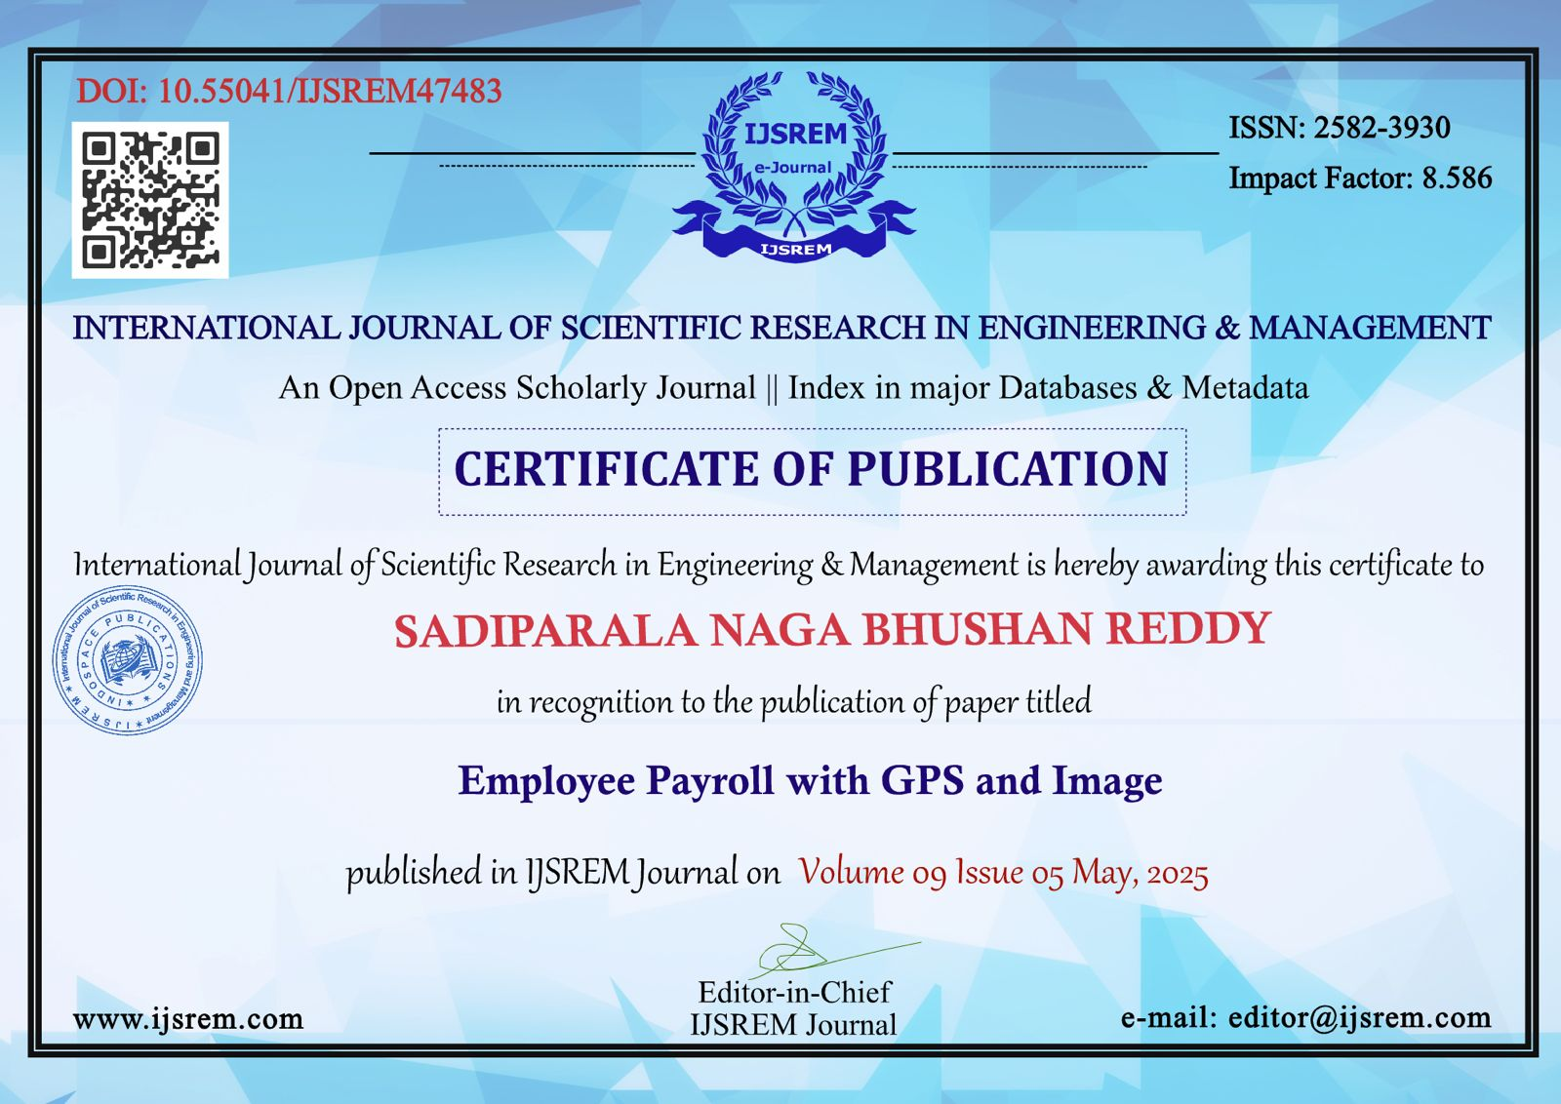
Publication Details

Slide 17

.

Slide 18
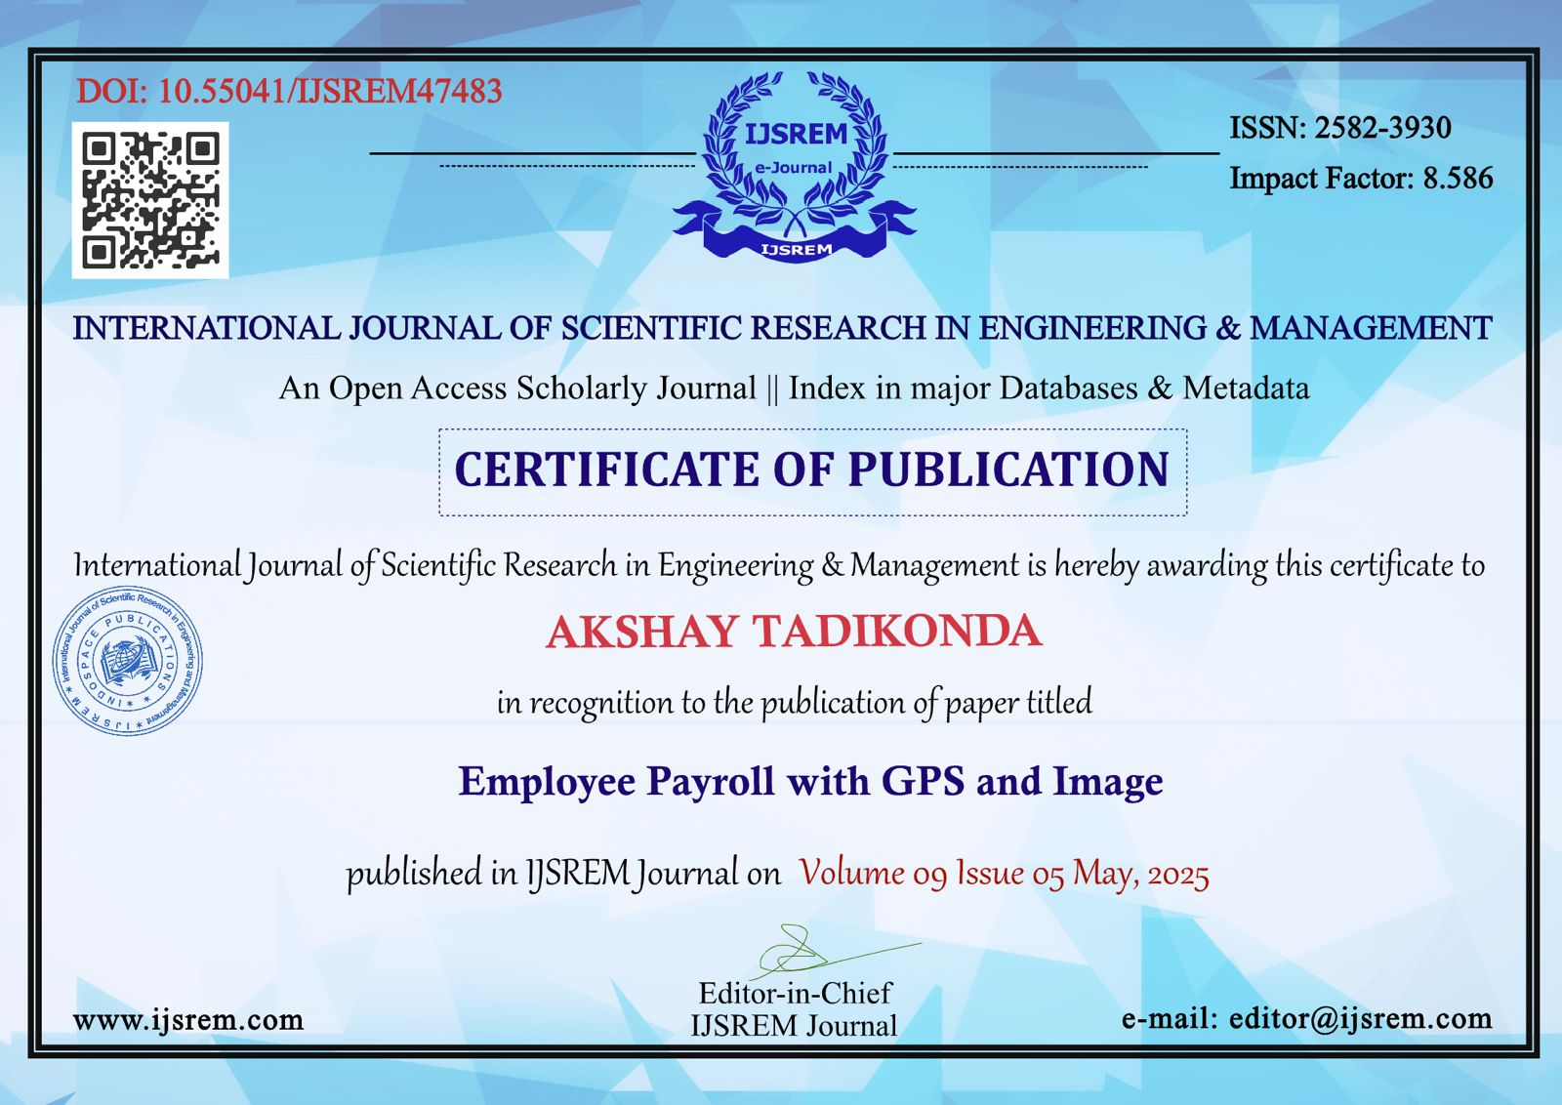
.

Slide 19
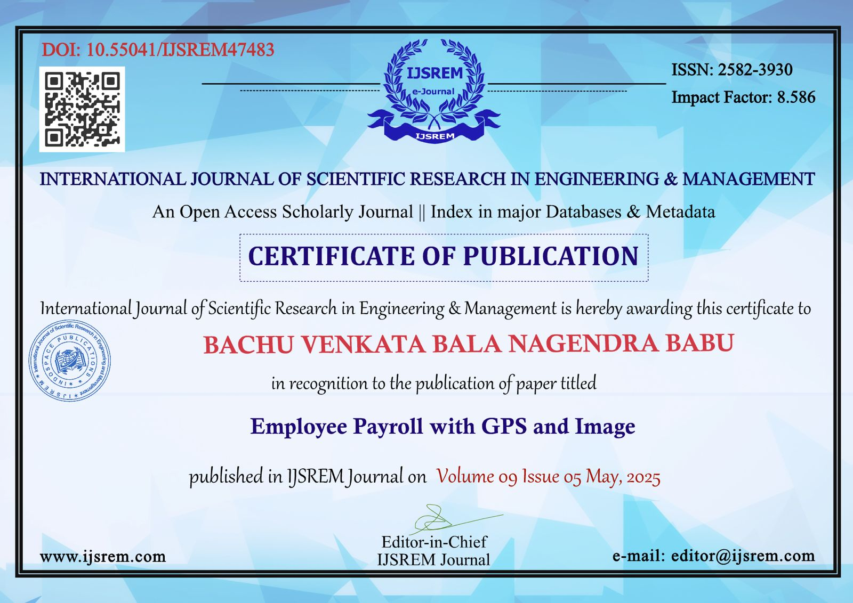
.

Slide 20

Project work mapping with SDG

Slide 21
Thank You

